Slide 1
THE TRAVEL APPROVAL & EXPENSE REIMBURSMENT PROCESS AT STARK SEALING SOLUTIONS Phase 1 Presentation – Team Four – October 28, 2015

Slide 2

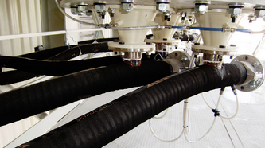
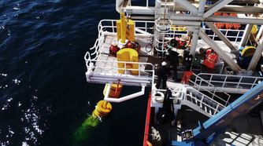
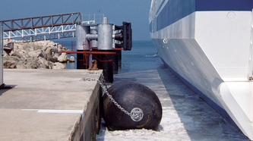
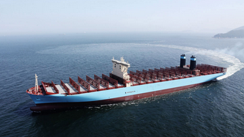





The business: Stark Sealing solutions
A German company with 5,000 employees that has grown tremendously in size within the last five years
3,000 employees have to work client sites at a regular basis
Growing number of complaints regarding the processes around traveling and expense reimbursement
As most companies, Stark asks employees to advance the money spent on business travel
The process currently in place is paper-based and sequential and takes to much time for all people involved
Stark Sealing Solutions has reached a size where it needs an IT-based, parallelized approach

Slide 3
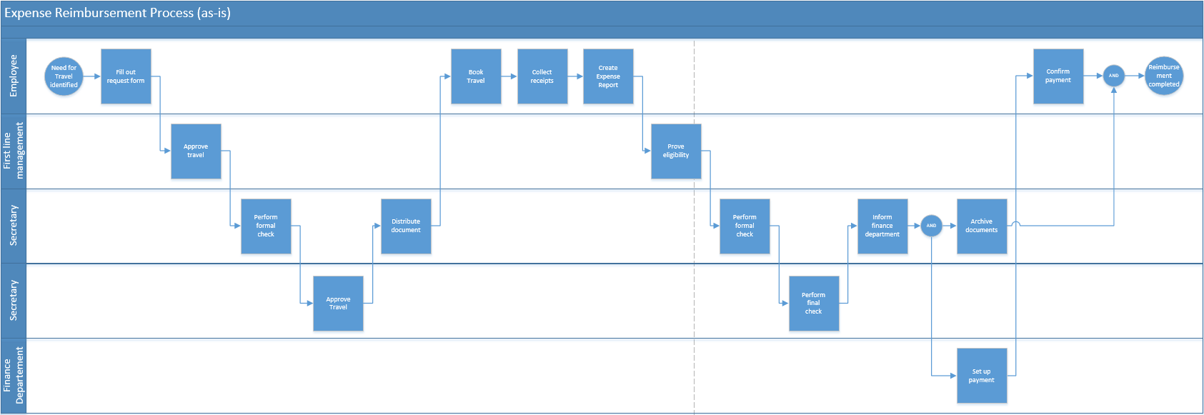
The current process

Slide 4
Problems with the process
The process takes too much of the employees and managers time
If managers or the CFO are not available, the employees may take non-compliant work arounds, can’t book and travel at all, which leads to customer dissatisfaction
Many employees can’t afford paying for more than one business trip in advance.
Process would take ~45 minutes to complete – but documents are in waiting position 95% of the time
Paper-based approach is compliant but not convenient
Difficult to get a history of an employees trip
Difficult to discover potential fraudulent activities
Difficult to get a status of an open request/report
Many errors occur during handover or when comparing requests/reports
Project managers struggle to locate and assign travel-related costs to their projects

Slide 5
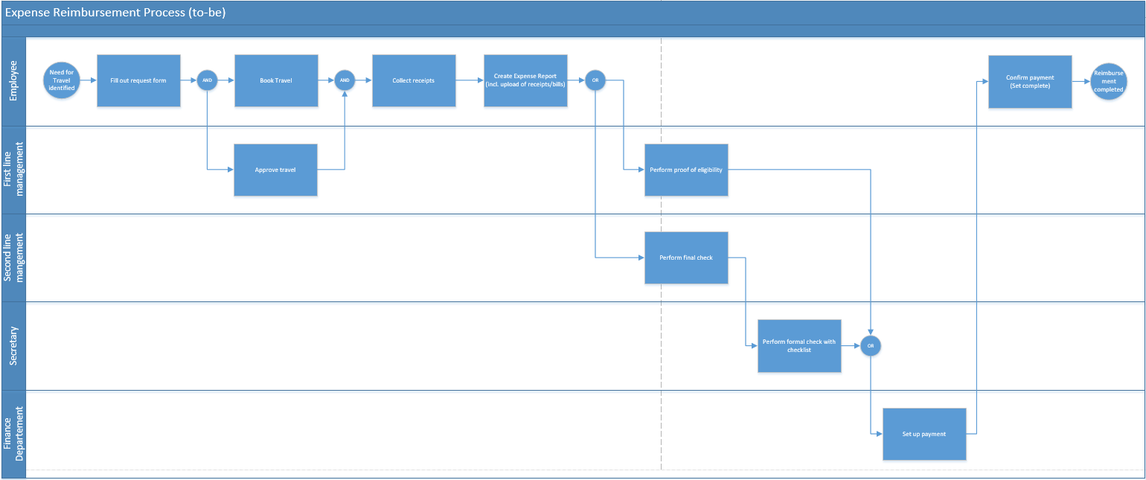
The proposed solution
Central aspects of redesign
Booking and approval is now parallelized
Proof of eligibility and formal check are performed in parallel
CFO delegates the travel request approval to the first line manager
CFO only deals with requests above $500, the rest is handled by the first line manager
Central database includes
Requesting and approving travel
Creating expense reports and uploading receipts
Automated messages to manager/finance department if action has to be taken
Linkage between travel requests and expense reports
View for project managers on travel cost for their project

